Slide 1

Wine and Food Pairing Recommendation System
AI Boot Camp Project 3
Team Members:
Asmaa Boualem
Michael Cirino
Essence Doucet
Johnathan Marsh
Notes:
Asmaa

Slide 2
Project Purpose / Description
Project Overview
Project Overview: This project aims to develop a personalized wine recommendation system that helps users select wines based on their past preferences, taste attributes, and ideal food pairings. The system will leverage a structured database, integrate user feedback, and provide dynamic suggestions using rule-based algorithms or potential machine learning models.
Goal: To create a functional and user-friendly wine recommendation system that allows users to explore and receive personalized wine and food pairing recommendations, making wine selection easier and more enjoyable.
Notes:
Asmaa

Slide 3

Goals/Problem to be solved
Project Overview
How can user preferences be effectively captured and translated into personalized wine recommendations?
What characteristics (body, acidity, tannins, etc.) in the judge’s descriptions are most important in user wine selection?
What machine learning or rule-based algorithms can enhance the accuracy of recommendations?
Notes:
Jonathan

Slide 4
Overview of data collection, cleanup and exploration process
Project Overview
Dataset Collection
1. Portugueses Wine Dataset - Portuguese Wine Reviews Dataset from "BlogOsVinhos" - dataset by loliveira1999.
2. Wine Searcher - Wine and Food Pairing.
Dataset Exploration
1. Dataset data was reviewed by the team to insure we had an adequate amount of data for use by the LLM.
Notes:
Asmaa

Slide 5
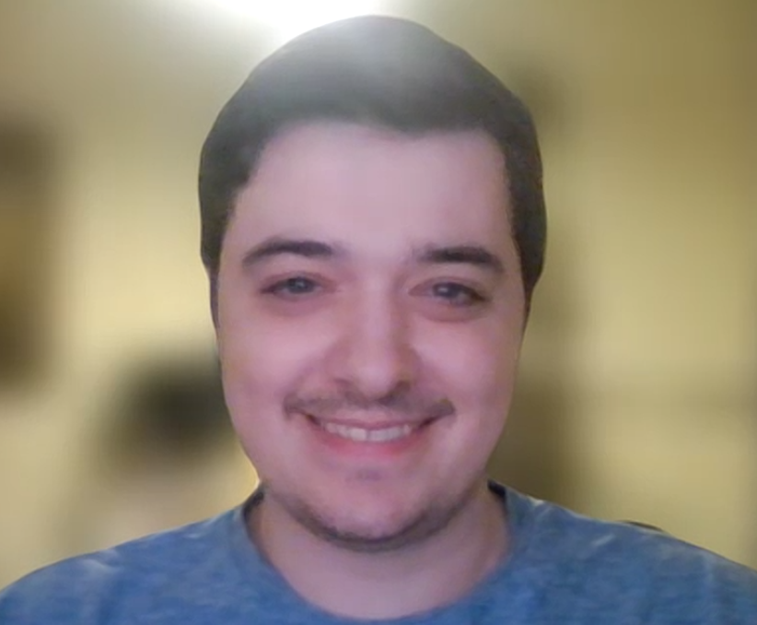
Overview of data cleanup
Project Overview
1st CSV
Output
(basic features + translated)
Basic Cleaning
(drop Nulls, convert to English)
2nd CSV Output
NLP Parsing + Hard Values
Starting
Os Vinhos
XLSX
Parse with spaCy
Numerical Values from original spreadsheet
(Price, Alcohol Content, and Color
Notes:
Jonathan

Slide 6
Internal CSV Output Values
Project Overview
Filtered Data from Os Vinhos
Name | Color | Alch Percent | Price | Judge Rating | Review_Notes | Wine_Bottle_Label | Web URL
NLP Data from spaCy parsing
color | aroma | flavors | finish | mouthfeel
Expanded Aroma Feature:
aromas_aroma | categories | subcategories | outer_ring_attributes

Slide 7
Null Values before
Null Values after
99% Reduction!
Improving Aromas
Project Overview
2nd CSV Output
NLP Parsing + Hard Values
Parse Review_Notes with Wine Aroma Wheel
Categorize the results
Output: More detailed Aroma info
BlogOsVinhosTranslated_With_WineProfile.csv
Aromas | 652
Wine Aroma Wheel CSV
(Category, Subcategory, Outer_Ring_Attribute)
Aromas_aroma | 7

Slide 8
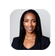
Approach taken to achieve goals
Project Overview
Langchain
Gemini AI
Generative AI
Google Translate
spaCy
Gradio Interface
Natural Language Processing
Notes:
Andrew

Slide 9
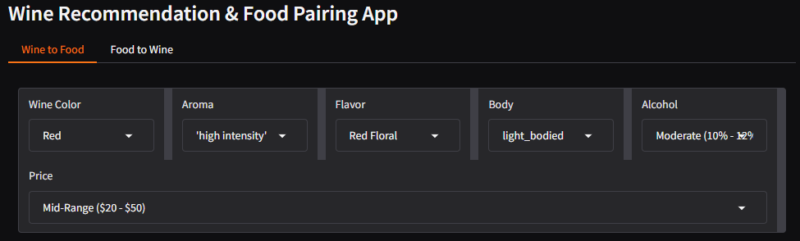
Result/Conclusion 1
Balance Ease of User Input with Many Variables
Simplify Reviewer Notes
Farming Key Attributes
Allow Some Wiggle Room
How can user preferences be effectively captured and translated into personalized wine recommendations?
Notes:
Essence

Slide 10
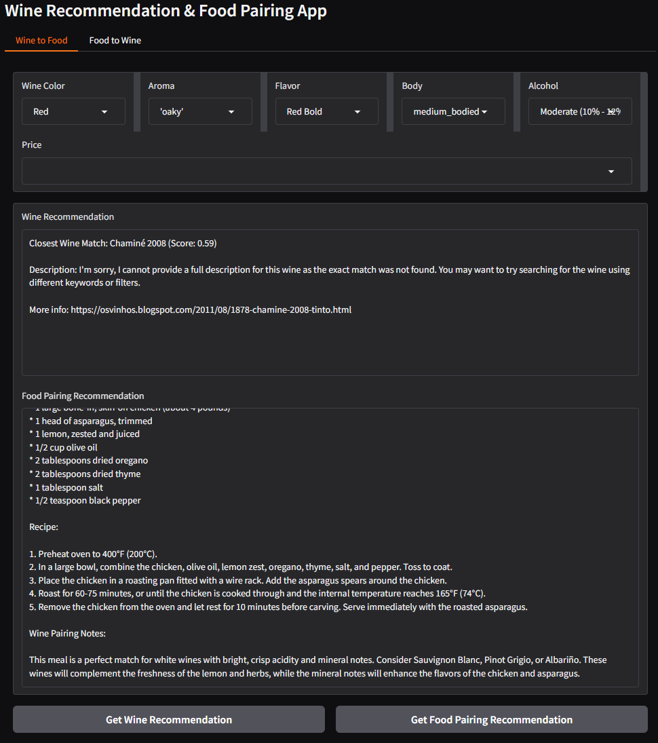
Result/Conclusion 1
Result/Conclusion 1
User Interface Wine Attribute Selection
Color (Primary)
Aroma
Flavor
Body
Alcohol Content (Select Your Buzz)
Notes:
Essence

Slide 11
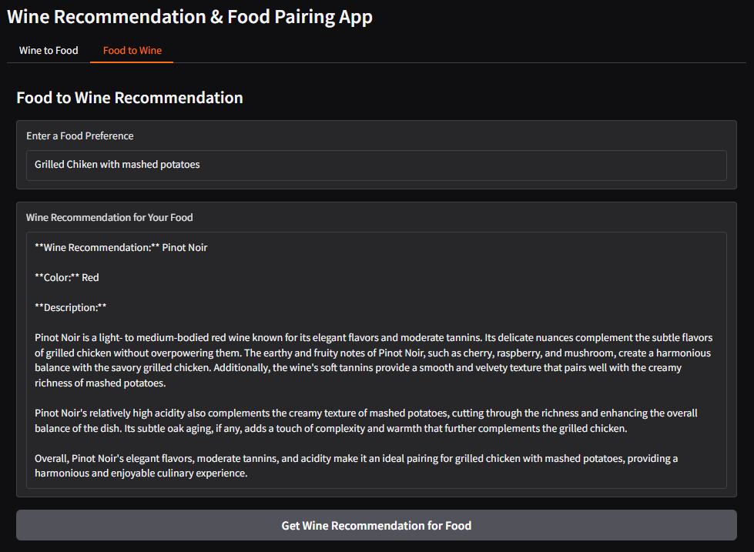
Result/Conclusion 1
Result/Conclusion 1
User Interface Wine Attribute Selection
Complete Freedom
Generative AI Recommendation
Delicious Results
Notes:
Essence

Slide 12
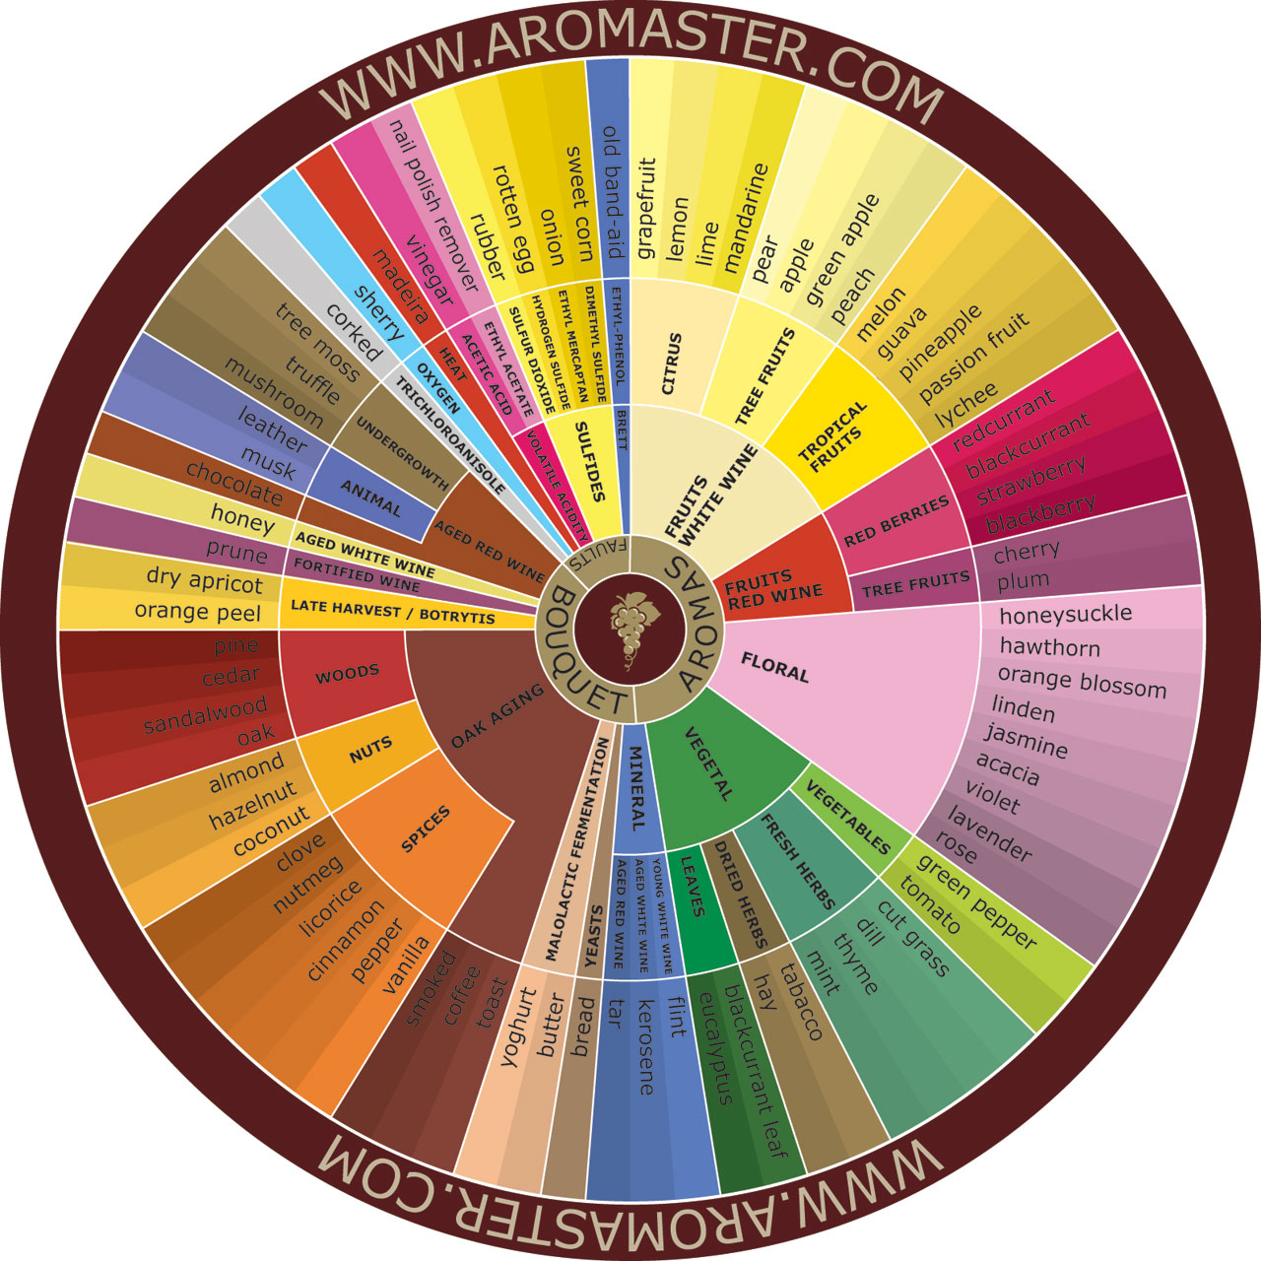
Result/Conclusion 2 Cont.
What characteristics (body, acidity, tannins, etc.) in the judge’s descriptions are most important in user wine selection?
Body
Acidity
Tannins
Sweetness
Alcohol
Notes:
Essence

Slide 13
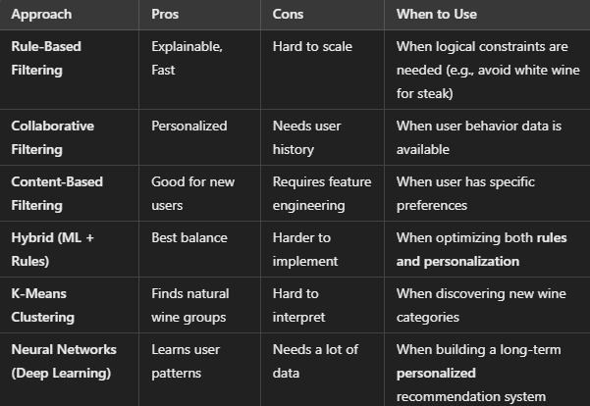
Result/Conclusion 3
What machine learning or rule-based algorithms can enhance the accuracy of recommendations?
Rule-Based Filtering
Collaborative Filtering
Content-Based Filtering
Hybrid (ML + Rules)
K-Means Clustering
Neural Networks (Deep Learning)
Notes:
Jonathan

Slide 14
Summary
The goal of this project was to create a functional and user-friendly wine recommendation system that allows users to explore and receive personalized wine and food pairing recommendations, making wine selection easier and more enjoyable.
Users are able to:
Search for wines based on attributes (e.g., sweetness, body, acidity)
Get food pairing recommendations
Get food pairing cooking instructions, and shopping list
Receive wine recommendations based on their preferences
Notes:
Andrew

Slide 15
Problems Encountered
Finding the best dataset that contains both wine characteristics and food pairings.
Balancing rule-based recommendations with potential machine learning approaches (i.e., should we use collaborative filtering or a predefined expert-driven approach?).
Developing an intuitive UI that effectively presents recommendations without overwhelming users.
Lack of subject matter experts on the team. (except Nathan)
Notes:
Austin

Slide 16

Future Considerations
The Wine Recommendation and Food Pairing App bridges the gap between wine enthusiasts and culinary delights. By combining data science, AI, and an intuitive interface, this app enhances the dining experience for users worldwide. We look forward to future iterations that refine and expand its capabilities.
Amending the wine list and notes
Saving of user wine preferences for repeat users
Rate wines to refine future recommendations
Notes:
Austin

Slide 17

Any Questions?

